Slide 1
Introduction to
Microcontroller
www.pantechsolutions.net

Slide 2
What is Microcontroller?
In simple term – Microcontroller is a small computer that is capable of performing specific task(s)
e.g car alarm, washing machine, handphone, PDA…
There are many similar names
Microprocessor-based system, controller, MCU, MPU, CPU…
They can be grouped into two classification
→ MCU - Micro Controller Unit
→ MPU - Micro Processor Unit
In general, these microcontroller are the brain of the embedded system

Slide 3
MCU and MPU
Classification | MCU |  |  |  |  | MPU
Chip | Embedded A CPU core, memory, peripherals, IO … into a single chip. |  |  |  |  | Contain only the main processor (CPU core)
Block Diagram of a system | MCU |  |  |  |  | Memory IO MPU Peripheral
 |  | CPU Core | Memory | Peripheral
 |  |  | IO
General Application Area | Self contained to complete a task. Targeted for small, compact, and low cost system |  |  |  |  | -Need external memory, peripheral to accomplish a task - Targeted for complex, high performance and expandable system
Processor (CPU) Core | 4, 8, 16 bit |  |  |  |  | 32 bit or above
Examples | 8051,pic16f887a,M16, H8, SH1/2 |  |  |  |  | SH3/4,8085
Application | Washing machine, car side mirror, air con |  |  |  |  | Handphone, PDA
3

Slide 4
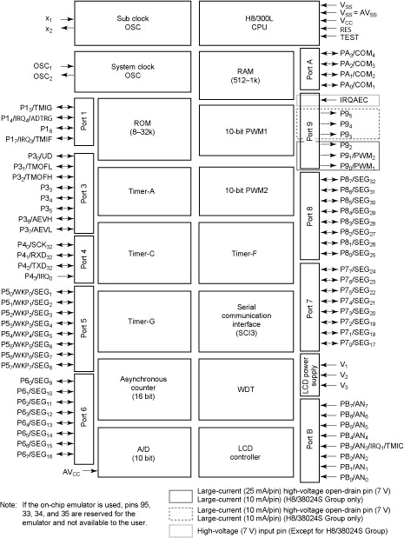
Components within MCU
Clock -sub | Processor Core
Clock -main | RAM
Processor core
Clock
Low power mode
Memory(ROM/RAM)
Input/Output Port
Timer / Counter/ WDT
PWM
ADC/DAC
Serial Interface
On chip Debug
Bus Controller
Other
ROM
PWM
 | Timer
 | Timer
Port | Timer Timer ADC
PWM
Timer
Serial Interface
WDT
LCD
Example of H8/38024

Slide 5
i. Processor core
Function
Fetch and execute machine code from memory
Efficiency & Effectiveness are determine by its architecture
Architecture Type
Word Size: 4, 8, 16, 32 Bit
Contains ALU (Arithmetic Logic Unit) for decision process
Contains General Registers for temporary storage and data manipulation
Contains Special Registers (PC, Condition, Stack) to assist in program control
Instruction Sets
RISC /CISC
Running Frequency / Voltage
Possible Measurement
MIPS (Million Instruction Per Instruction)
Number of machine instructions that a computer can execute in one second
Provide only a rough indication for comparison

Slide 6
ii. Clock
OSC1
OSC2
MCU needs a clock input to operate
It can have two clock sources
A. Main processor clock input
This clock may be divided or multiply to allow the processor to run at a slower speed (lower power consumption) or higher speed
B. Sub clock input
32.768KHz is the usual clock used as this allow accurate generation of a second via a 16 bit counter.
These clocks are normally fed via a crystal and two capacitors to the MCU.

Slide 7
iii. Low power mode
Low Power is achieved via various mean
Running at slower speed, such as sub clock(32.768KHz)
Sleep mode, sub-active, standby…
Shutting off unused peripherals
Module stop mode…
Standby mode consume only 1uA

Slide 8
iv. Memory (ROM/RAM)
ROM (Read Only Memory)
For program and fixed data storage
Size: as low as 1 KByte to as high as 512 KByte
Example
Masked ROM
Flash
PROM - Programmable Read-Only Memory
OTP - One-Time Programmable
RAM (Random Access Memory)
For data storage
Size: as low as 256 Byte to as high as 4 KByte
Example
SRAM

Slide 9
v. Input / Output Port
Basic interface to control (output) and monitor (Input) external events.
High current port
(20mA), so as to drive LED directly.
Open-collector/drain port
Interface to higher supply circuitry
Wired-Nor condition

Slide 10
vi. Timer / Counter / WDT
Timer (8 or 16 bit) are used to generate or measure timing for events.
External event trigger the count
Compare match to perform a task
…
WDT (WatchDog Timer)
Every time before the counter reach the predefined value, the working MCU will clear the counter.
Thus, if the counter is not clear within the specified timing, the WDT will reset the whole MCU as this signify that the MCU has run wild.

Slide 11
vii. PWM
PWM (Pulse Width Modulation)
– Generate continue pulse of preset duty cycle
This can be used to drive motor.

Slide 12
viii. ADC/DAC
ADC (Analog-to-Digital Conversion)
The basic peripheral to interface to the real analog world.
Characteristic
Accuracy is determine by number of bits (10,12,14…)
Sampling frequency
C
onversion technology ( Resistive ladder, Sigma delta…)
, AVSS and each analog input pins
– AVCC
Real World Data -> Temperature Pressure Sound…
Analog
Digital
Transducer
ADC
CPU
DAC (Digital-to-Analog Conversion)
– This operate in another way. It output the signal in analog form to the outside world

Slide 13
ix. Serial Interface
There are different serial interfaces
Asynchronous mode (2400 BaudRate…)
Synchronous mode (at higher transfer rate)
USB, I2C, SPI, CAN…(different communication standard)
Use for:
Communication with other devices, such as external RF module, PC…
Generally used only 3 pins
Serial In, Serial Out, and Clock

Slide 14


x. On Chip Debug
Circuitry Incorporated for development and debugging purposes
Usually few pins are required for the PC to control the MCU, via a “JTAG-like” emulator
– Mode pin
Data In/Out
Clock pin
PC
USB I/F
Target Board

Slide 15
xi. Bus Controller
In the higher performance MCU, a bus controller is incorporated to manage internal and external memory bus.
The external bus may be split into different areas, so that each area can be assigned with different setting
Refresh controller for DRAM
Longer wait cycles for slower devices

Slide 16
xii. Other
There are many possible peripherals that can be integrated into each MCU, to perform specific tasks, such as:
LCD controller
PLC
Ethernet MAC
Other components are:
Interrupts
LVD (Low Voltage Detection)
POR (Power On Reset)

Slide 17
MCU Connection
Flashing
/Debugging
(Optional)
Supply via battery or wall plug
VCC
Clock Mode Reset
Output Control Motor, LED,
MCU
Input Monitor Temperature, Switches…
GND

Slide 18
Choosing MCU
Reliability - good
Performance – speed, number of bits, architectures
Power consumption - low
Peripherals – require
Number of I/O pins - enough
ROM/RAM size – enough
Package and Size – manufacturing ease
Development Tool – available and ease of Use
Roadmap – for next expansion
Cost - low
Availability – short lead time
Support – technical team, application notes…

Slide 19
For more Tutorials
www.pantechsolutions.net
http://www.slideshare.net/pantechsolutions
http://www.scribd.com/pantechsolutions
http://www.youtube.com/pantechsolutions
5/24/2011 9:38:29
PM
© Pantech Solutions Pvt Ltd. | All rights reserved
www.pantechsolutions.net

